Slide 1
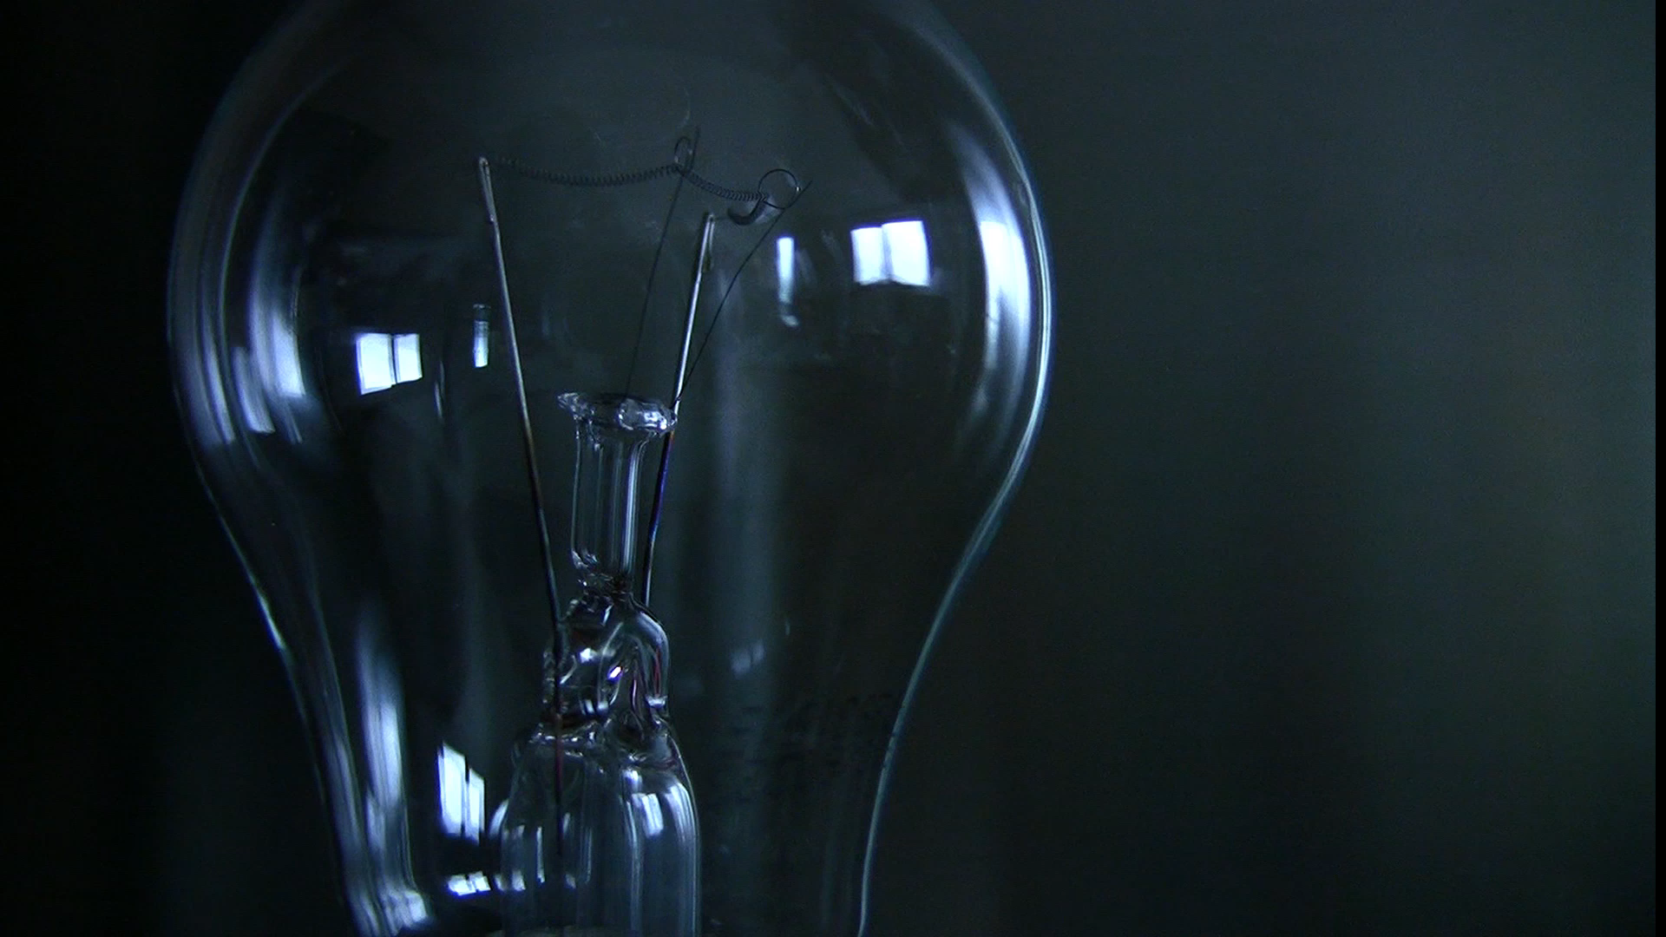
De-Light Initiative
- Harshal Utekar (Project Manager) Harsh Pratap Singh Devendra Gaud Pradnya Tipare Bhagyashree Parkar Yashasvi Sharma

Slide 2
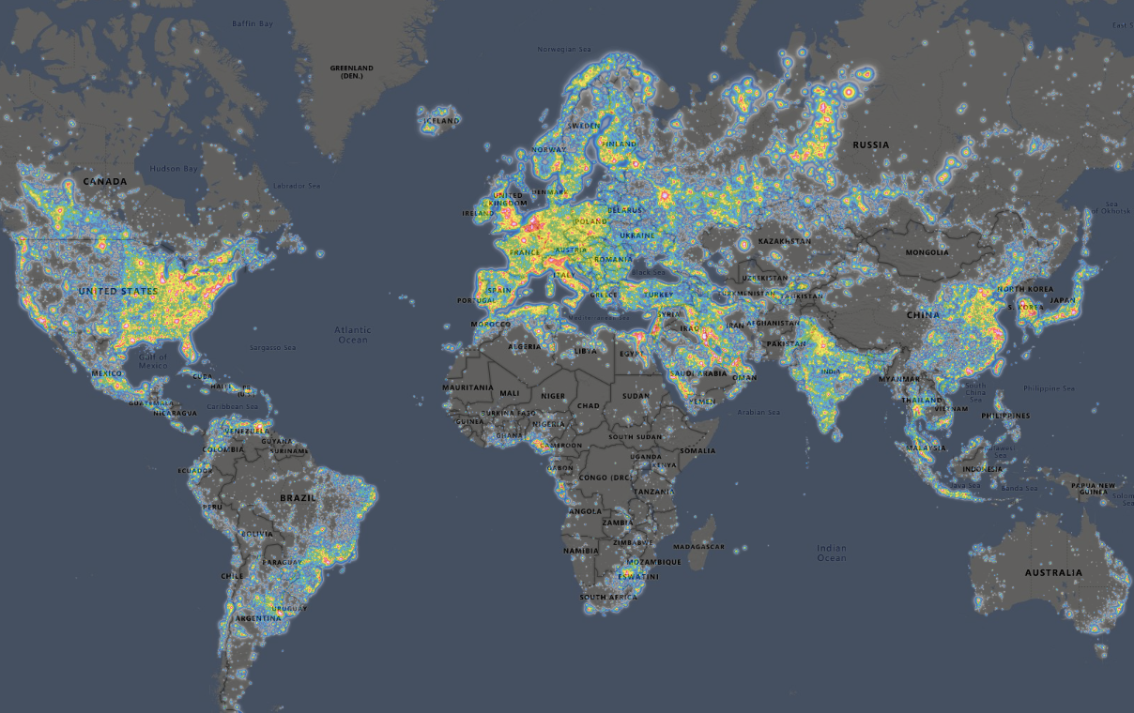
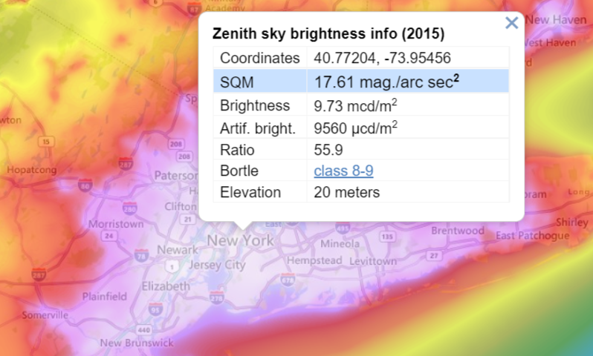
Why Light Pollution?

Slide 3
Causes
Building exterior and interior lighting
Advertising
Commercial properties
Offices
Streetlights
Illuminated sport venues

Slide 4
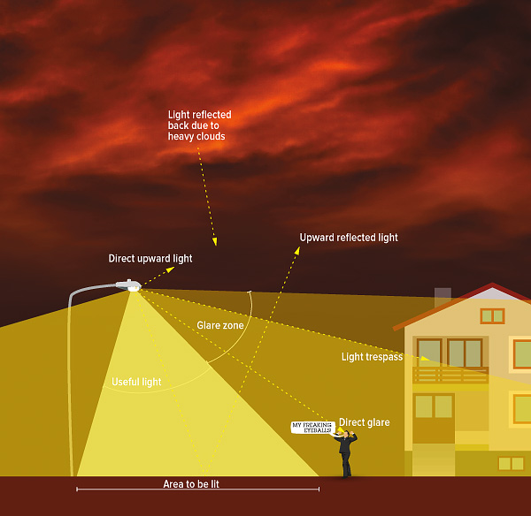
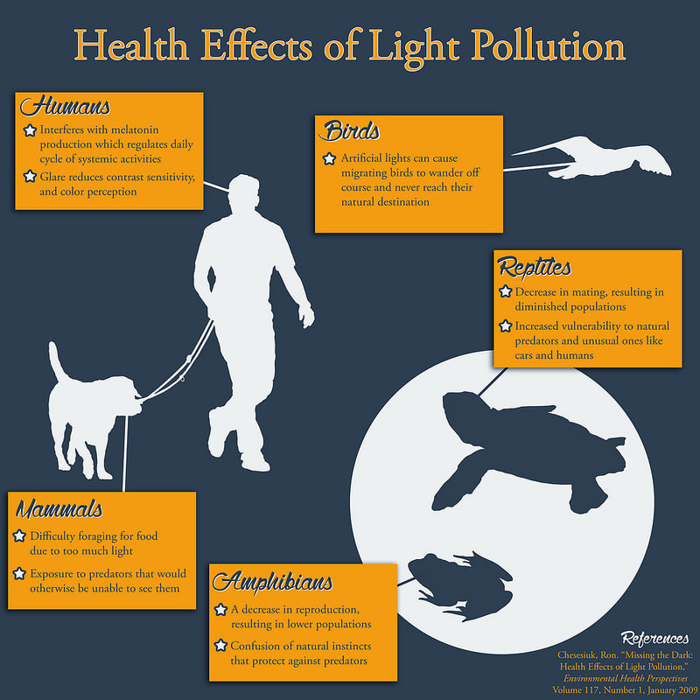
Effects
Components

Slide 5
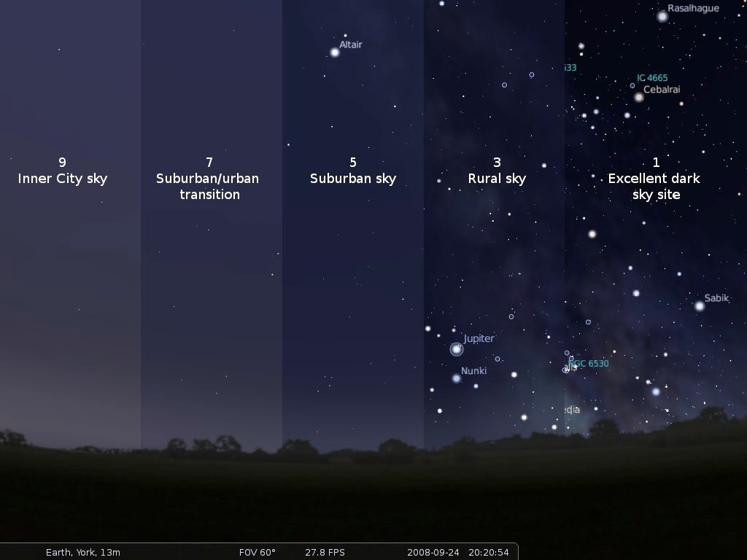
AIM AND OBJECTIVE
Pitch project idea
The goal for 1st year
Minimize High-intensity lights
Spread Awareness
Laws and policies
Lights fixtures(CRI)
Reduce adverse Health effect
Illuminating natural night sky

Slide 6
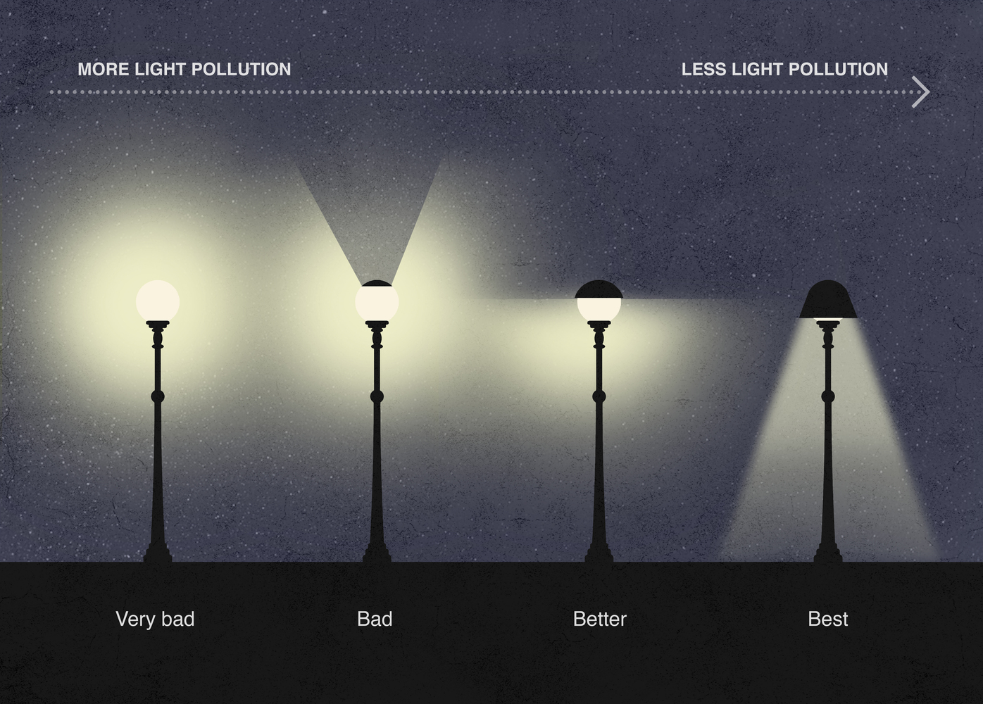
WAYS TO MINIMIZE LIGHT POLLUTION
Street-Lights fixture
Eco-friendly lights
Reduce Unnecessary light Usage
Advance notice for the corporations
Public Awareness

Slide 7


How?
1. Spreading awareness through online and social campaigns
2. Contacting supplier for E-light fixtures

Slide 8
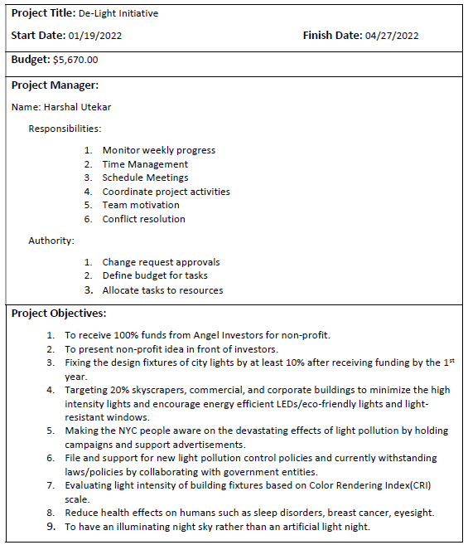
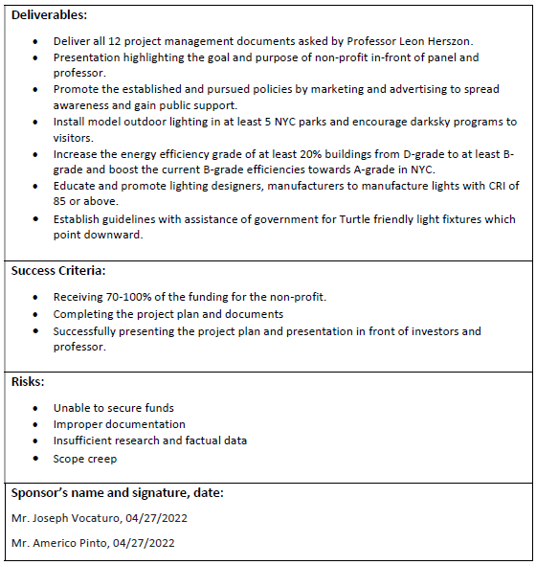
1. PROJECT CHARTER

Slide 9
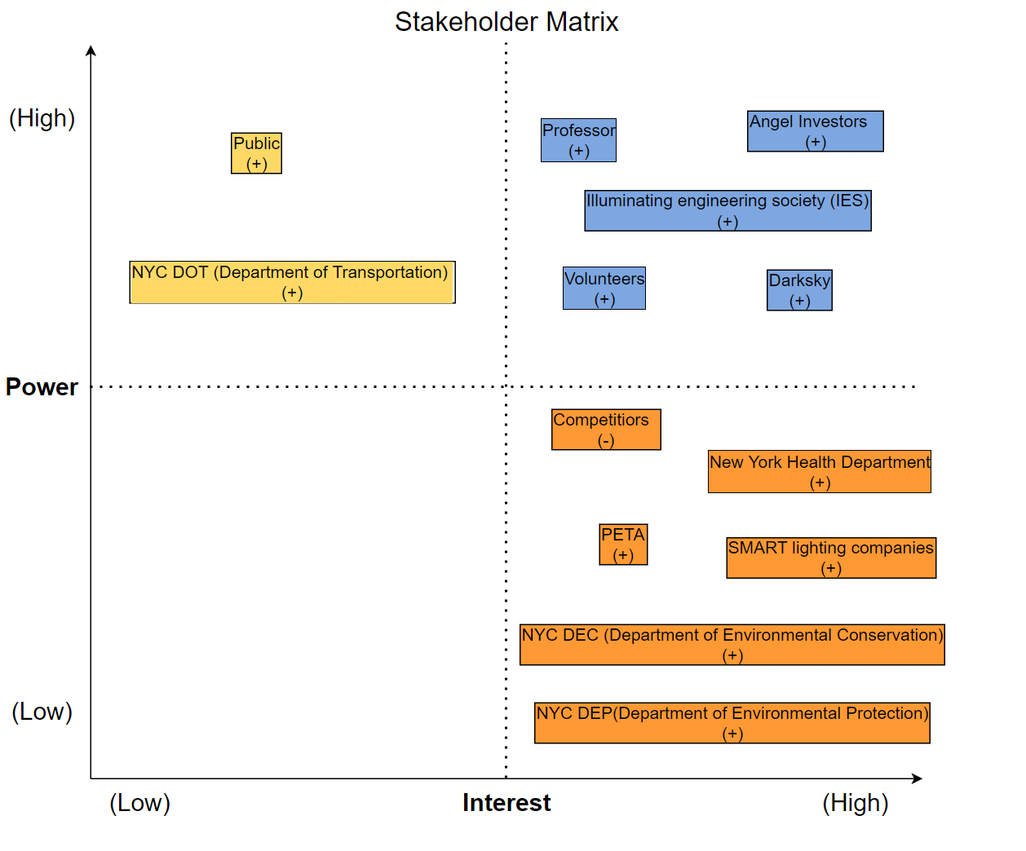
2. Stakeholder Matrix

Slide 10
3. LIST OF REQUIREMENTS
A. DarkSky/IES
Obtaining Sky Quality Index, Classify Bortle-Scale, Policies, and Standards of Light Illumination
B. Volunteer
Carry out all the activities for the Non-Profit Organization
C. Angel Investors
Present 100% detailed project plan and obtain sponsorship from the Angel Investors to run the campaign
D. Public
Educate them about Light Pollution, its Impacts, and the importance of eco-friendly lights.
E. Eco-friendly Light supplier
Sell eco-friendly lights to the Public and provide samples to volunteers

Slide 11
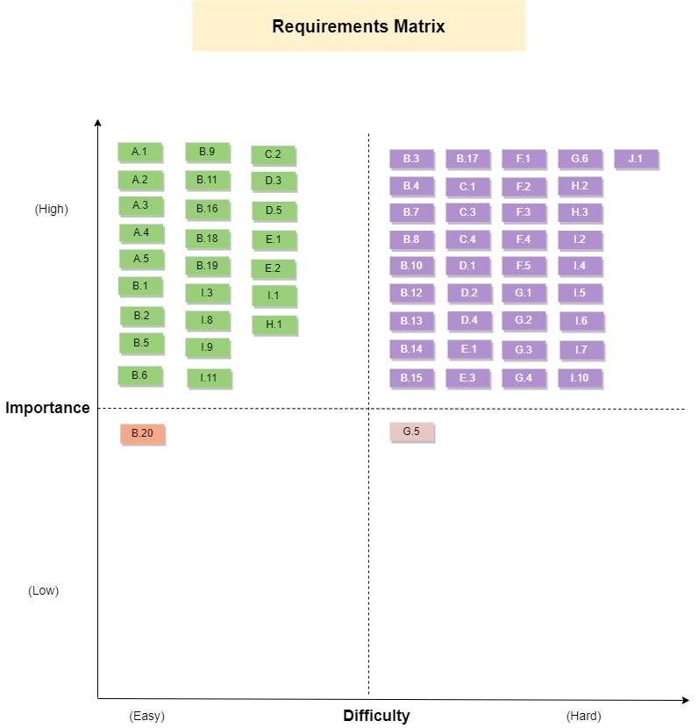
F. NYC Dot/NYC Dec/ NYC Dep
Providing necessary legal information, insights and contribute to awareness campaigns.
G. PETA
Provide evidence-based information about the adverse effect of light pollution on animals, fishes and marine life.
H. New York Health Department
Provide evidence-based information about the adverse effects of light pollution on humans.
I. Professors
Create 13 Project Management documents. Create a presentation and present it on 27th April 2022.
J. Competitors
Future collaboration should be considered in order to get a bigger audience and reach goals.

Slide 12
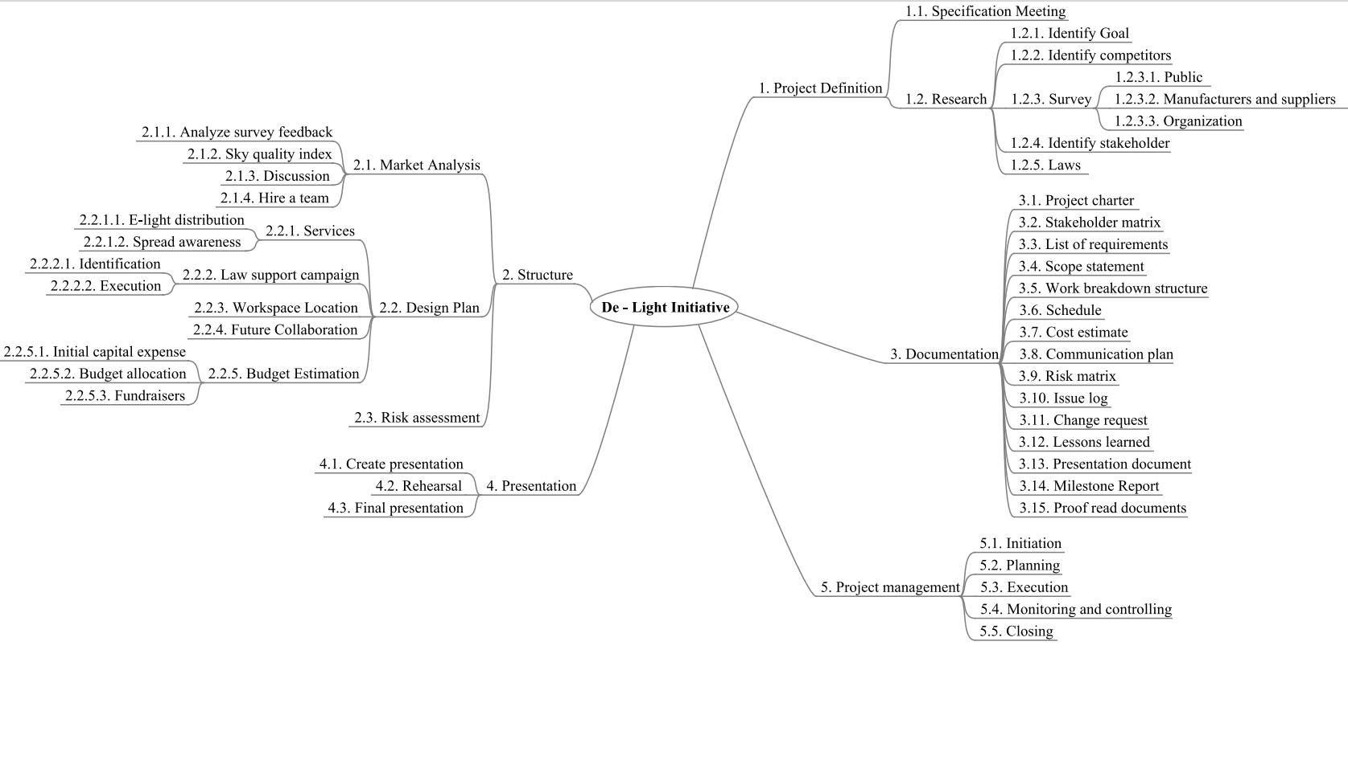
5. Work Breakdown Structure

Slide 13
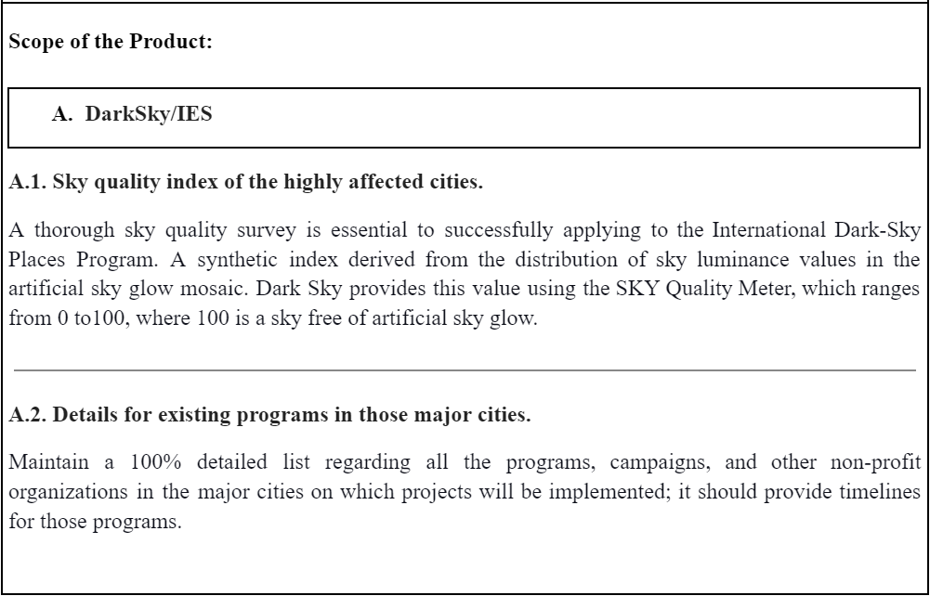
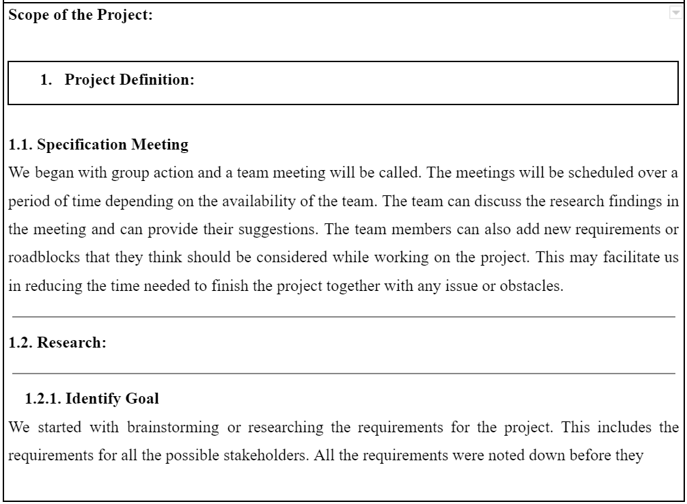
4. SCOPE STATEMENT
Product Scope
Project Scope

Slide 14
Project Assumptions:
The project would be within budget.
We would finish the project on time.
We would secure at least 80% of the funding.
We would receive at least 75% of grants and funds from multiple organized fundraisers.
Our program would educate and make at least 50% of the NYC population aware about the impacts
Out of Scope:
Creating light supplies that have CRI scale of 90 and above
Providing healthcare assistance for light pollution related health effects.
Expanding the target location beyond NYC.
Compensation for volunteers on E-light supplies

Slide 15
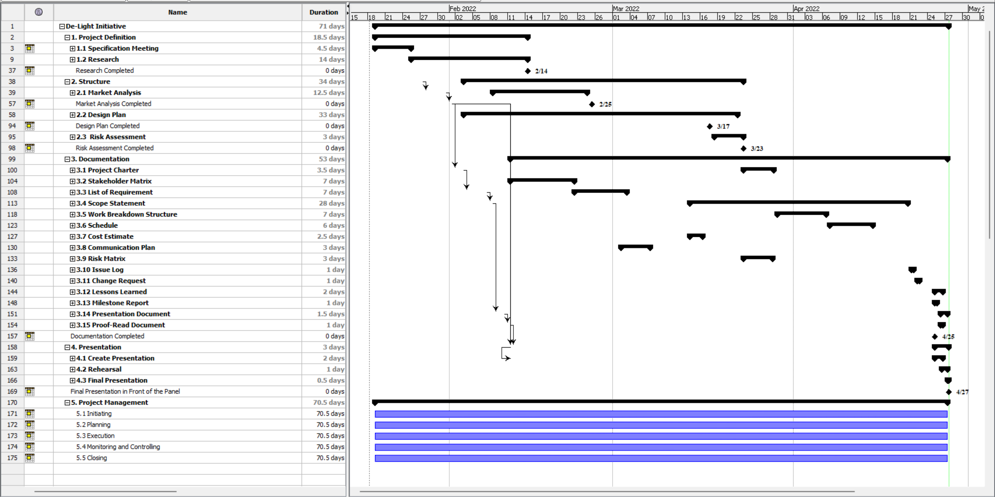
6. SCHEDULE

Slide 16
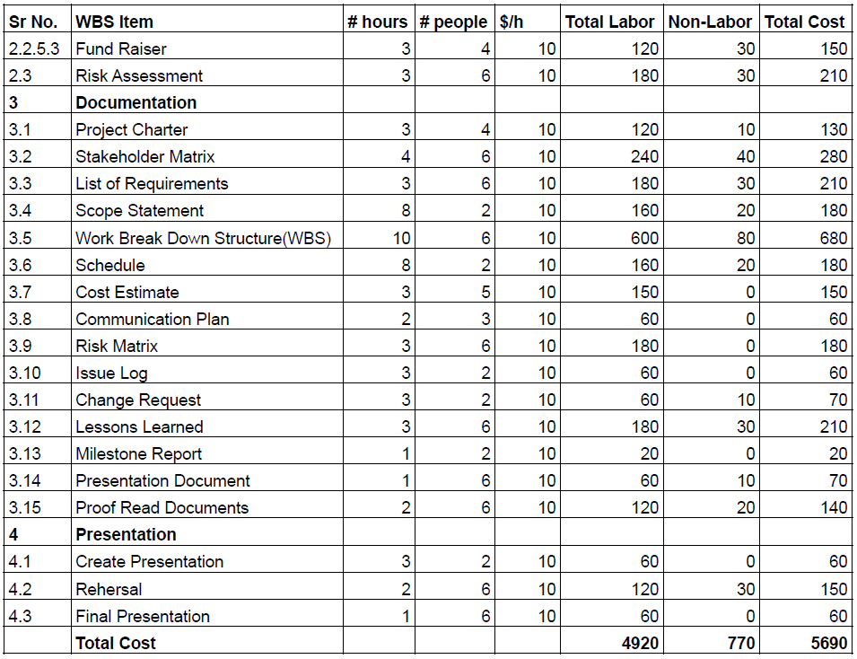
7. COST ESTIMATE

Slide 17
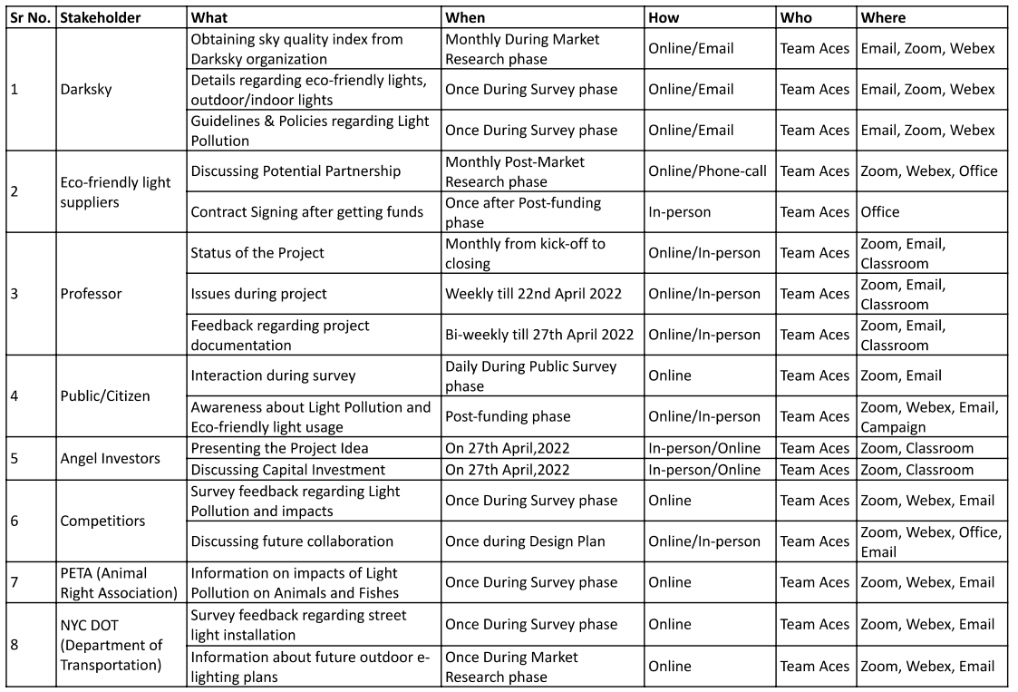
8. Communication Plan

Slide 18
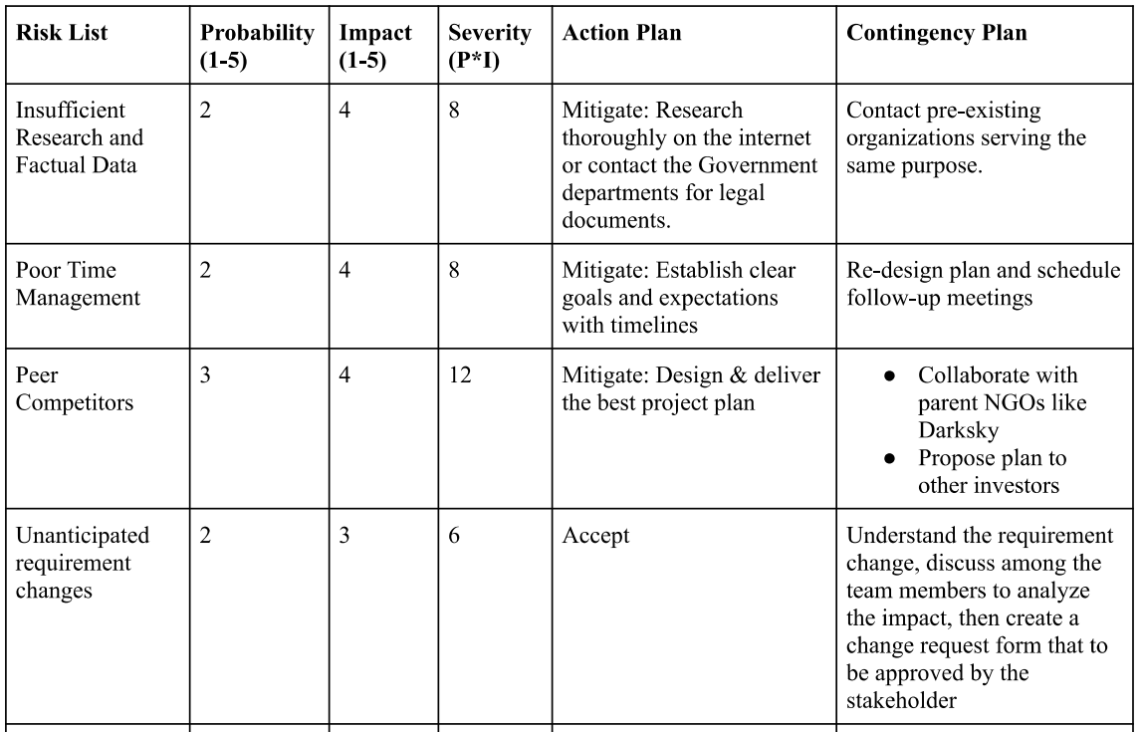
9. RISK MATRIX

Slide 19
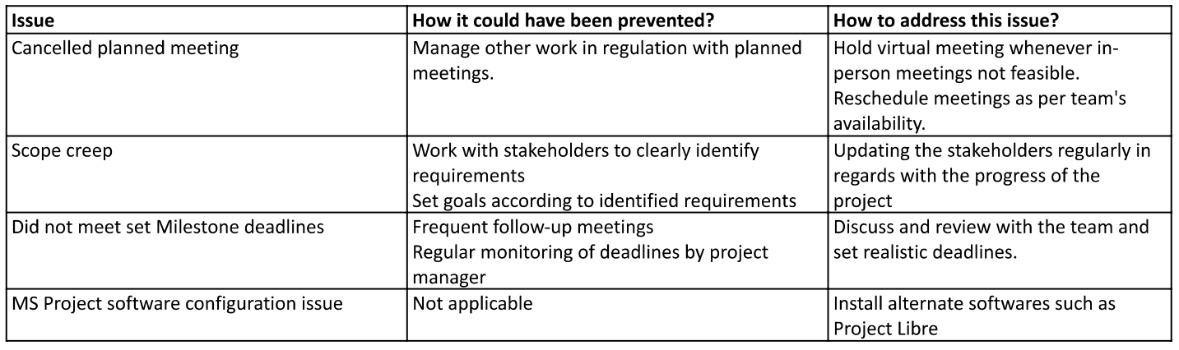
10. ISSUE LOG

Slide 20
11. Change Request
Added Milestones in the Schedule.
Removed sub-levels from WBS.
Modify the Requirement matrix with code names.
Modify the Risk matrix probability and impact for identified issues.

Slide 21
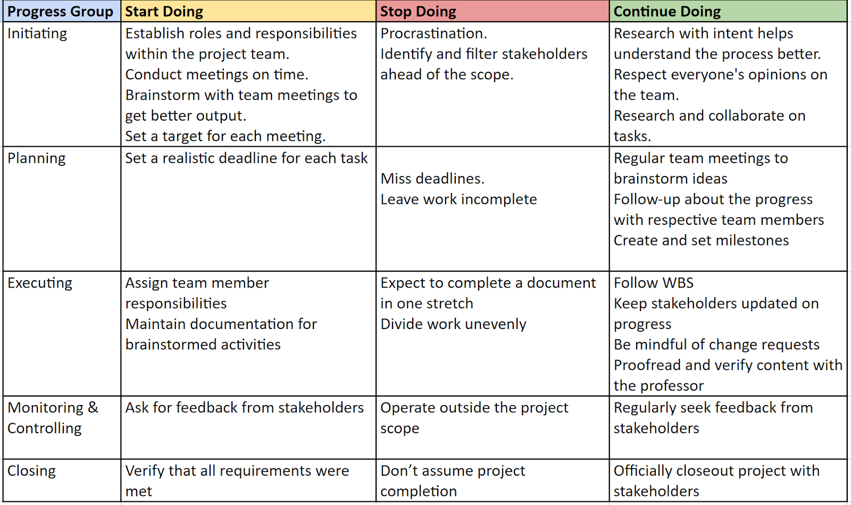
12. Lessons Learned

Slide 22
Future Scope:
Support campaigns and marketing.
Signing deals with the manufacturers and suppliers.
Distribution of e-lights.
Collaboration with Government Entities.
Collaboration with competitors.
Organizing Fundraisers

Slide 23

Thank You!
Questions?

